Slide 1
Computational cognitive science I Ideal Bayesian Observer
Filip Děchtěrenko

Slide 2


Where is Waldo?

Slide 3


Slide 4
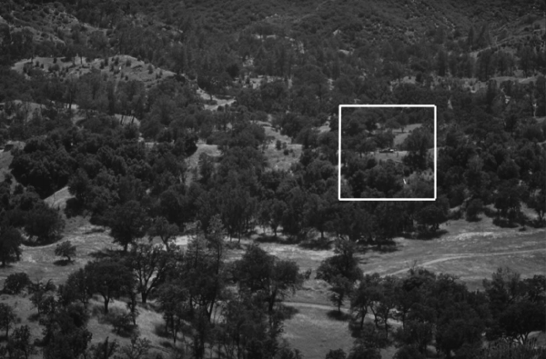
What about real tasks?

Slide 5
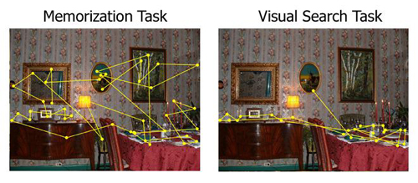

Slide 6
Real scenes are complicated -> let’s simplify it!

Slide 7
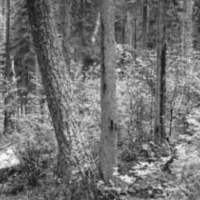
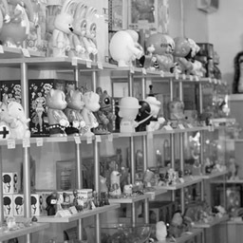
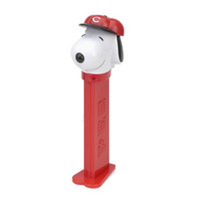
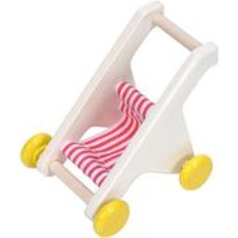
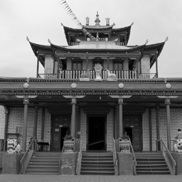
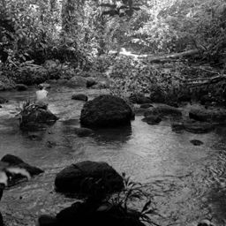
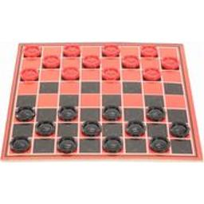
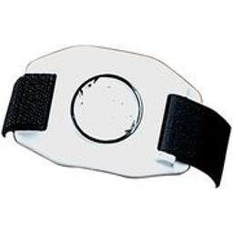
Scenes and targets are too variable..

Slide 8
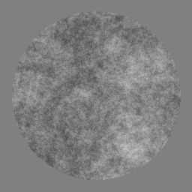

…use stimuli with similar properties!
noise 1/f
gabor patch

Slide 9
Easy task
Find Gabor patch in a noise

Slide 10
●

Slide 11
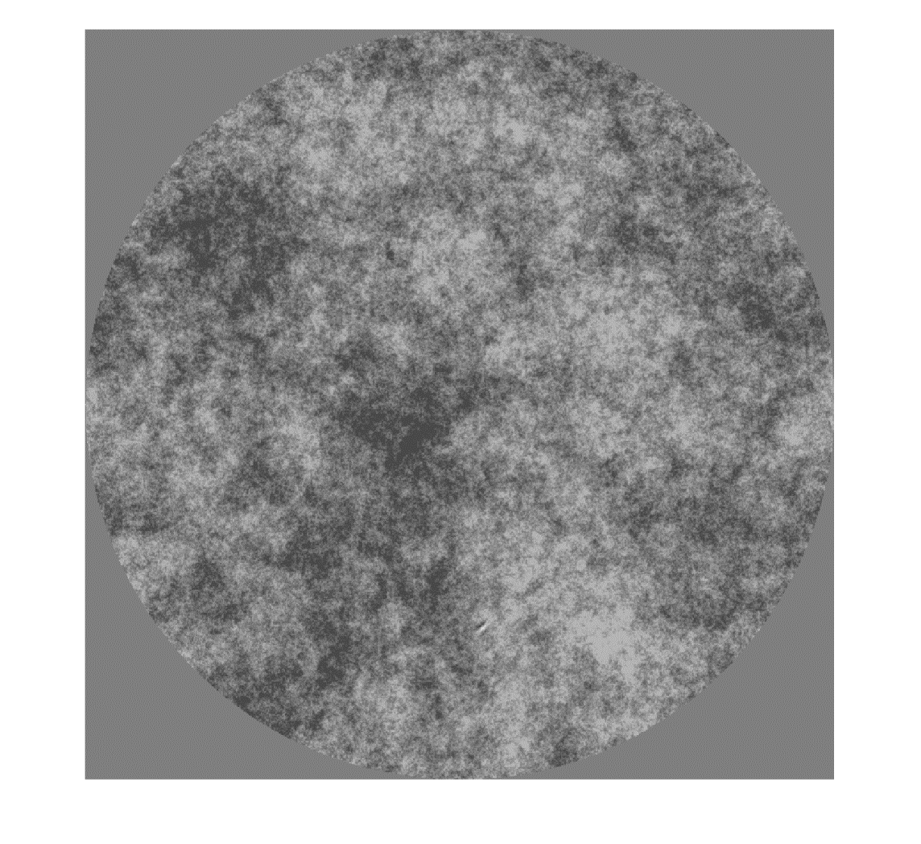

Slide 12
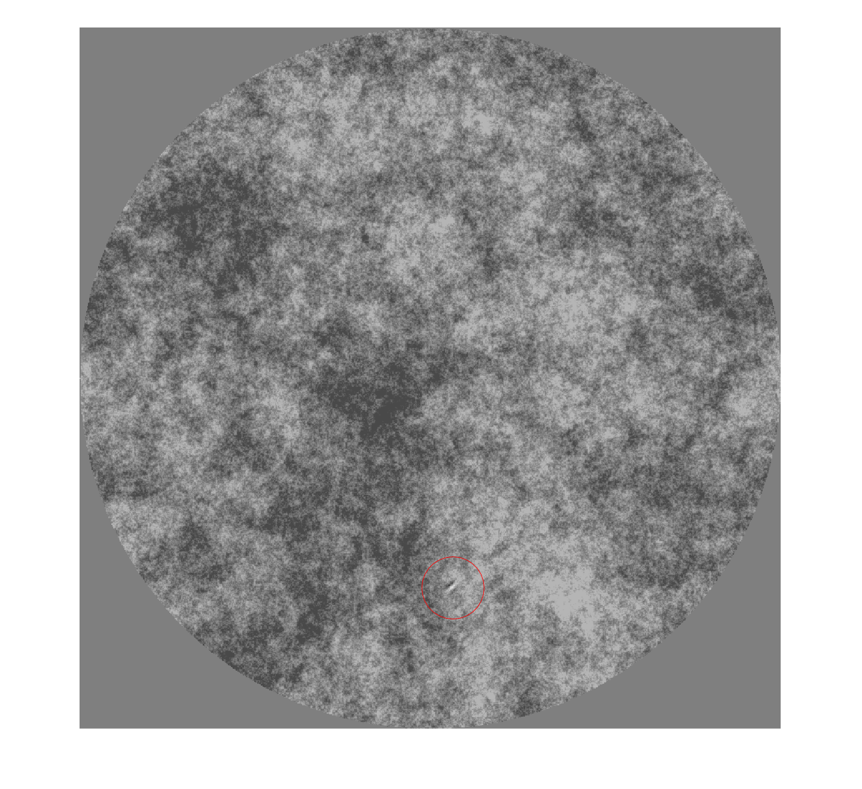

Slide 13
Difficult task
Find Gabor patch in a noise

Slide 14
●

Slide 15


Slide 16
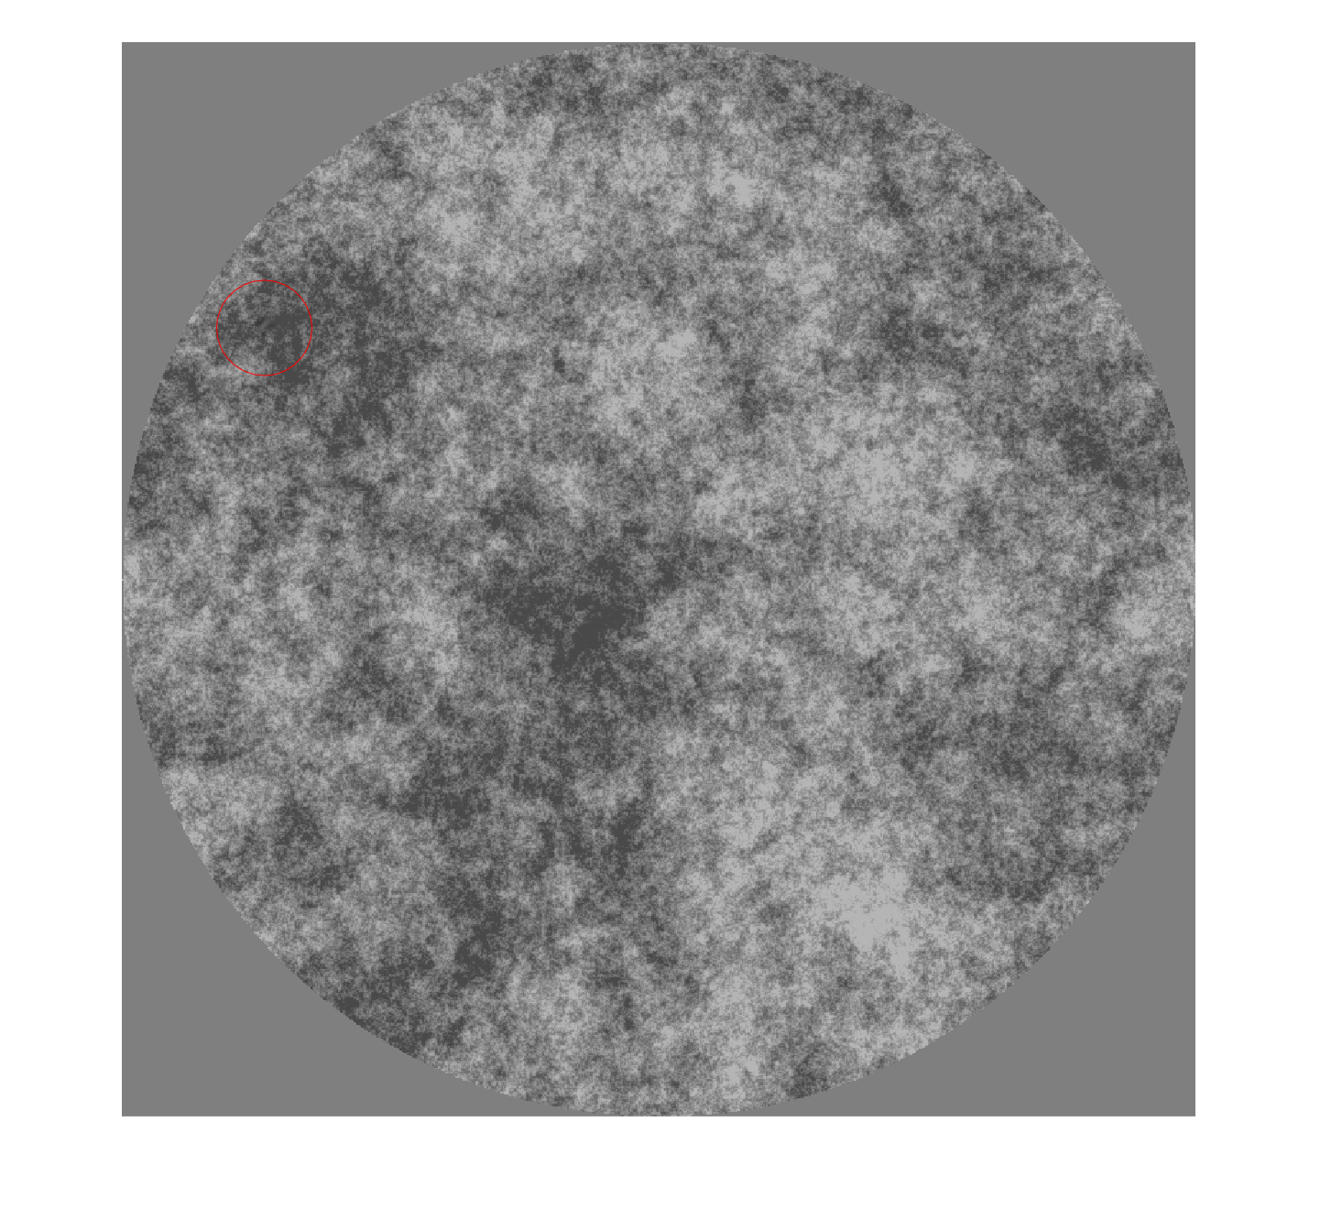

Slide 17
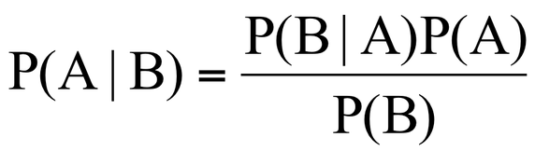
Ideal Bayesian Observer
An ideal observer is a hypothetical device that performs a given task at the optimal level possible, given the available information and any specified constraints. If the ideal observer can be derived for a given task, then it can serve vision research in several important ways:
Identifying task-relevant stimulus properties.
Describing how to use those properties to perform the task.
Providing a benchmark against which to compare the performance of real or model vision systems.
Suggesting principled hypotheses and models for real performance.

Slide 18
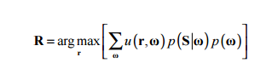
Ideal Bayesian Observer- in general
ω : unknown state of the world
S : observed stimulus
r : response of the system
p(S|ω) : likelihood of stimuli given the state of the world
p(ω) : prior probability of the state of the world
u(r, ω) : cost of the answer r given the state of the world ω
Notes:
Z = g(S;θ), kde Z je nějaká utilita, kterou se snažíme maximalizovat a g je biologické omezení systému (např. Z je počet fotonů v každém fotoreceptoru, g(.) je zobrazení stimulu z očí do fotonů ve fotoreceptoru, θ jsou parametry závislé na problému

Slide 19
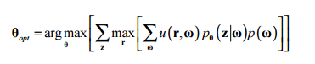
Ideal Bayesian Observer with constraints
Transcription of the stimuli to percept is not lossless
We have biologically encoded limitations
Therefore it is more likely:
Where Z = g(S;θ), Z is transcription of the stimuli into internal representation, g is biological constraint of the system
e.g. Z is count of photons at each photoreceptors, g(.) maps stimuli to photons in photoreceptor, θ are parameters related to the question, which we try to find

Slide 20
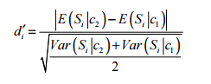
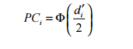
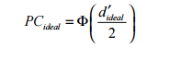
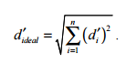
Independent sources of information
Example: We have two target categories. We have n sources of information S = (S₁, S₂, S_{n}), where S_{i} is number of spikes generated by i-th ganglion cell on the retina
Therefore ideal observer has chance of responding correctly

Slide 21
Signal detection theory

Slide 22
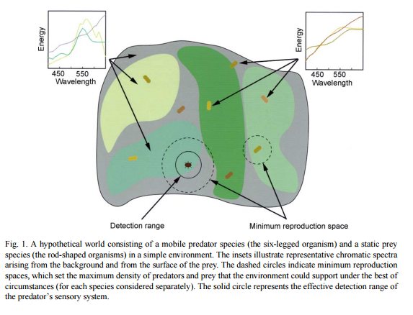
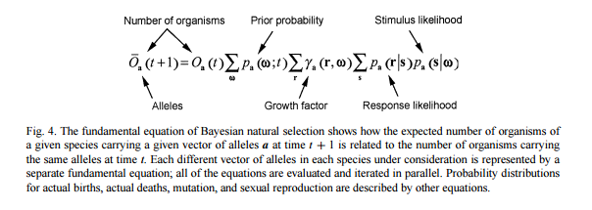
Evolution goes to IBO

Slide 23
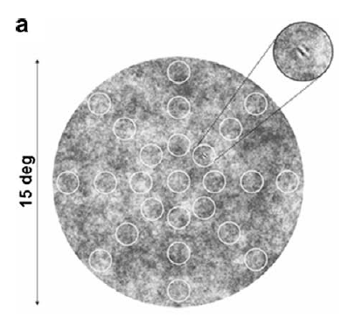
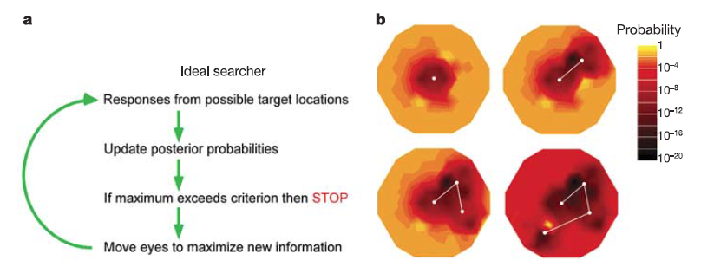
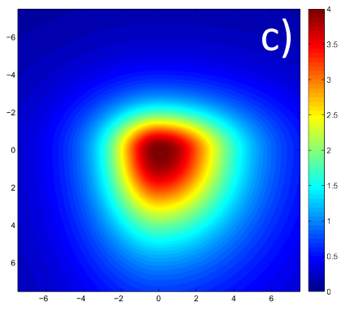
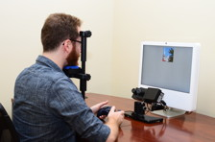
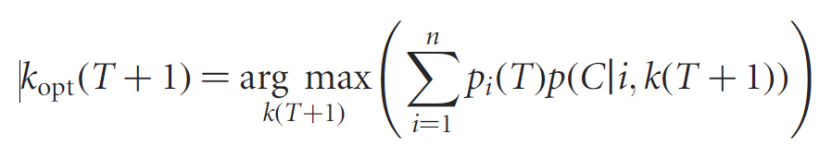
IBO for visual search

Slide 24
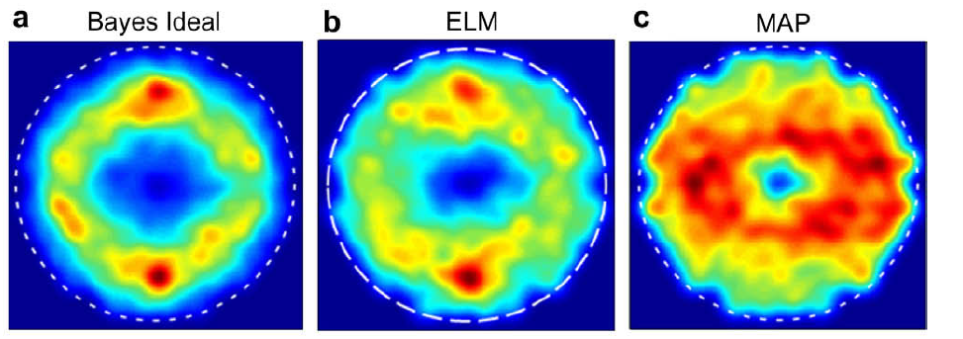
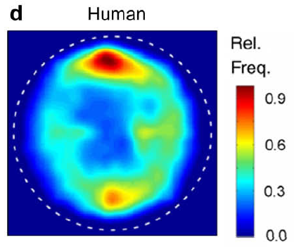
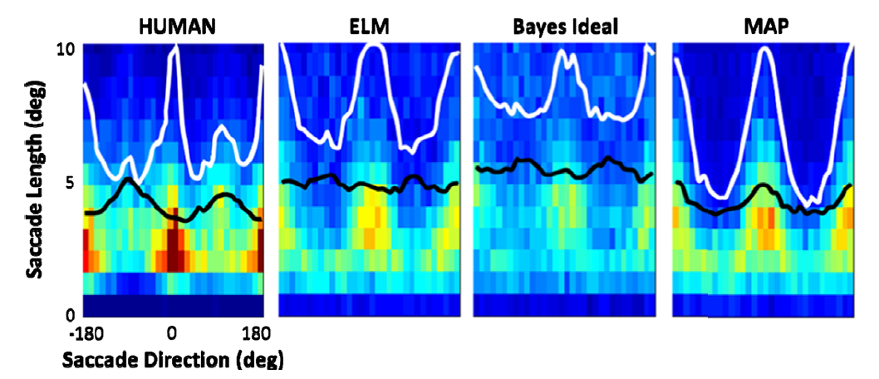

Slide 25
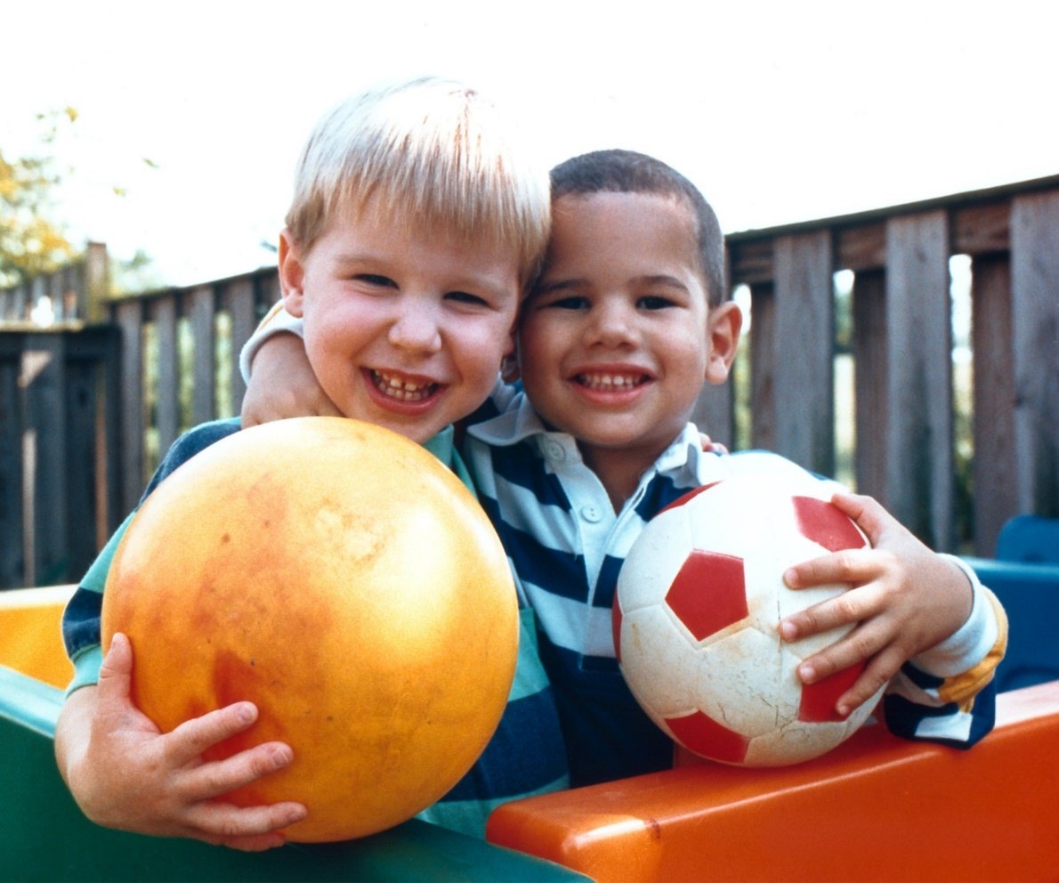
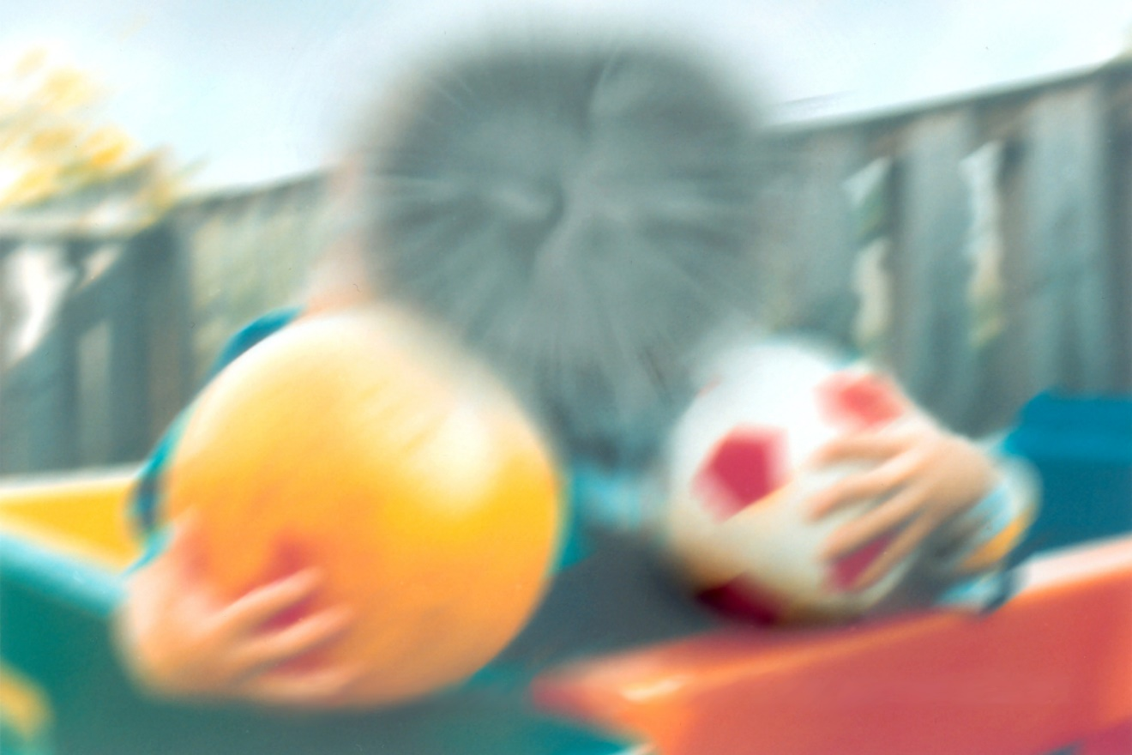
Macular degeneration

Slide 26
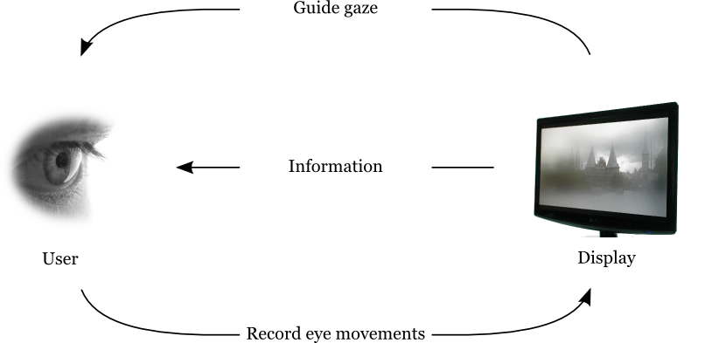
Gaze-contingent displays

Slide 27
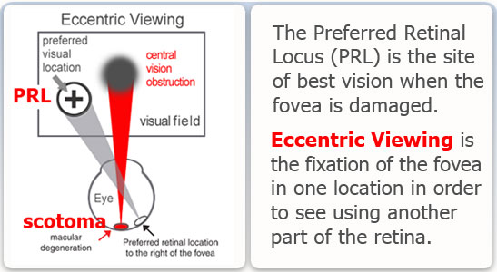
Preferred retinal locus
Training increase performance up to 250% in visual search
In reading, training increase performance from 9 words per min to 68 words per min
But it takes time..

Slide 28
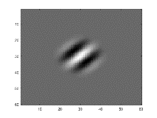
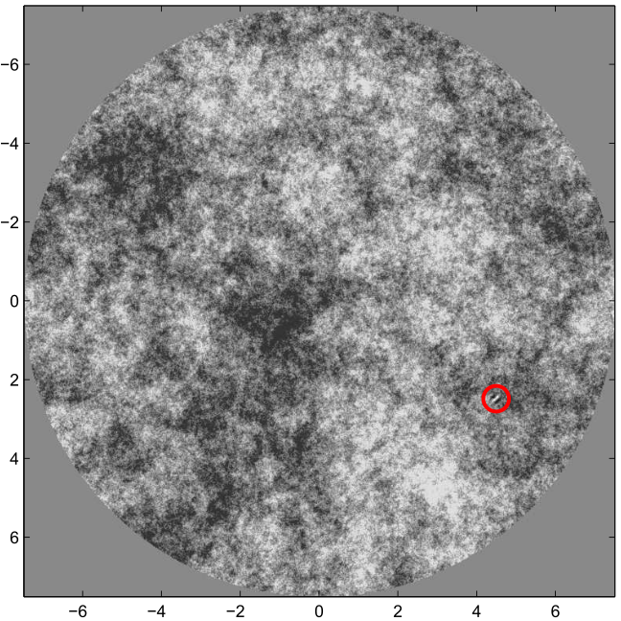
Visual search – normal condition
One subject (me☺)
N = 400 trials
1/f šum, r.m.s. contrast = 0.1
target: Gaussian (6 c.p.d) + raised cosine envelope
Eyelink 1000

Slide 29
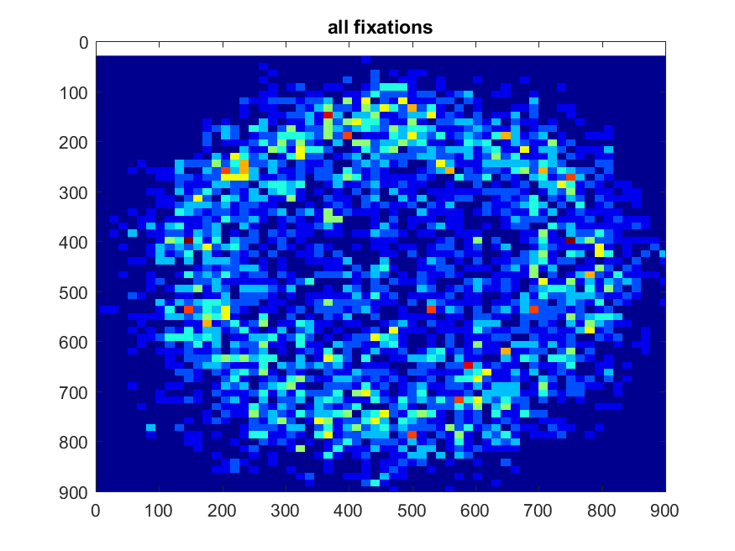
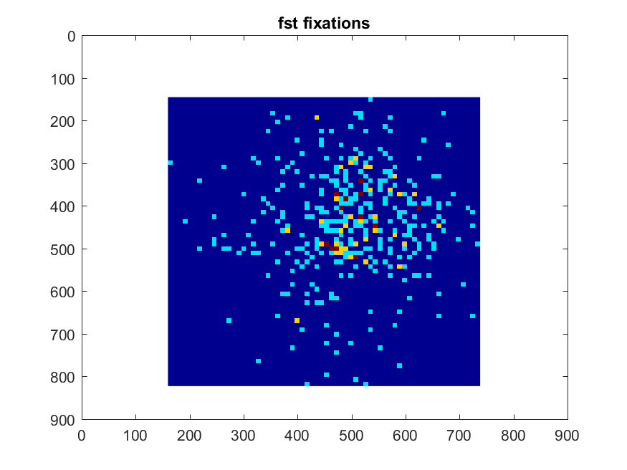
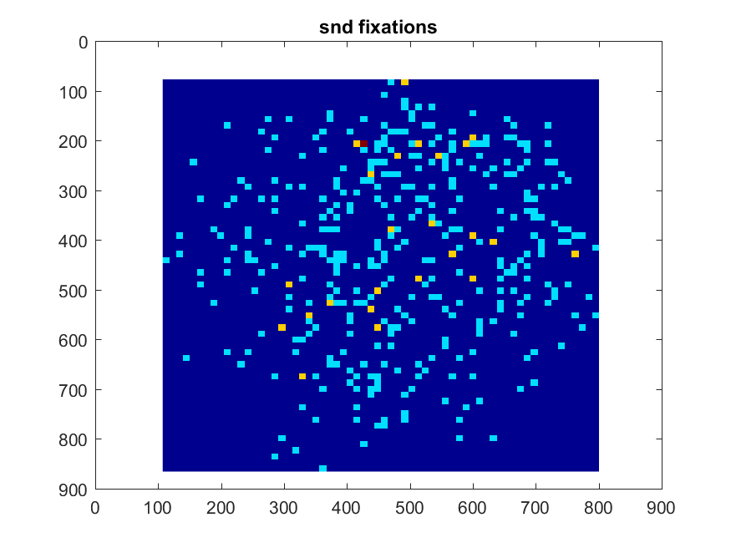
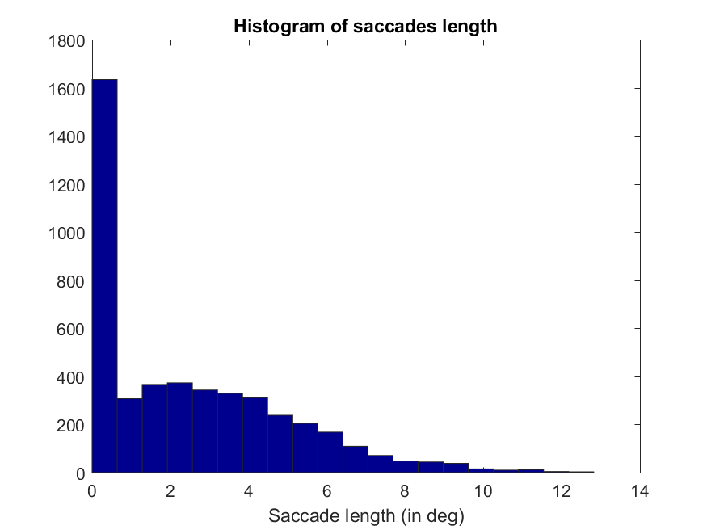
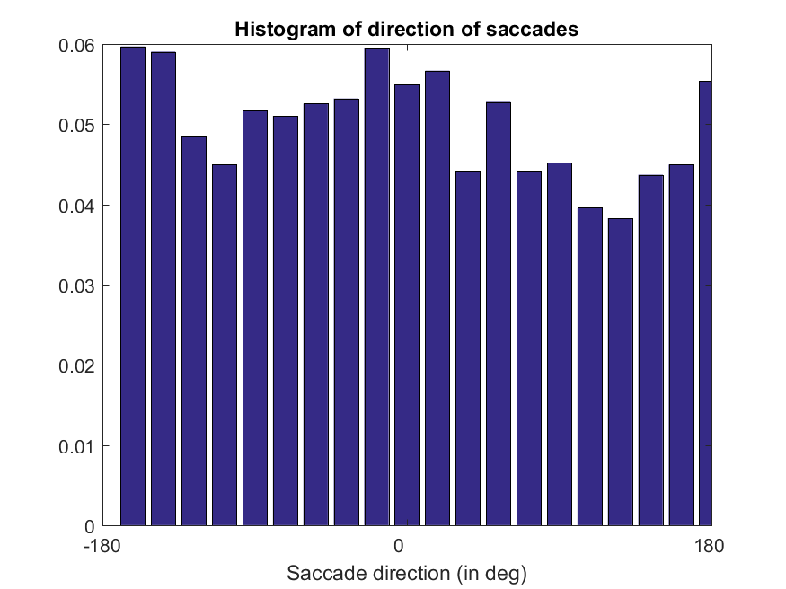
Results – Eye movements

Slide 30
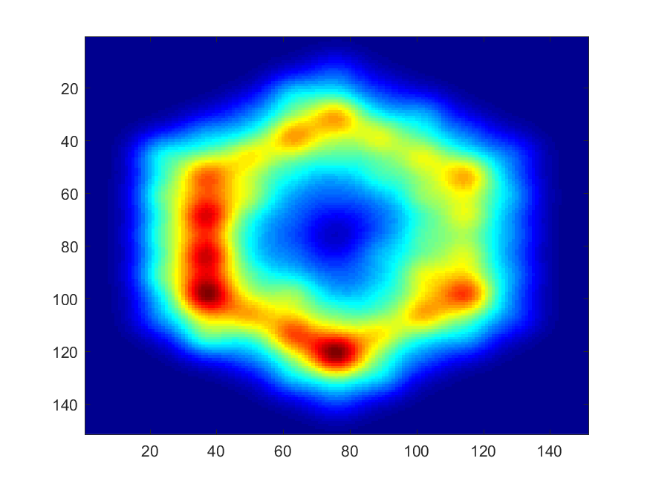
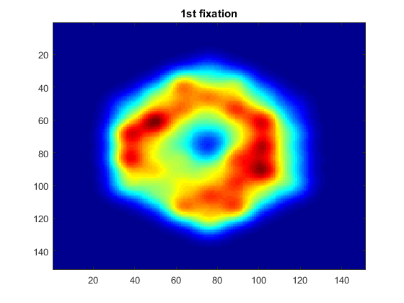
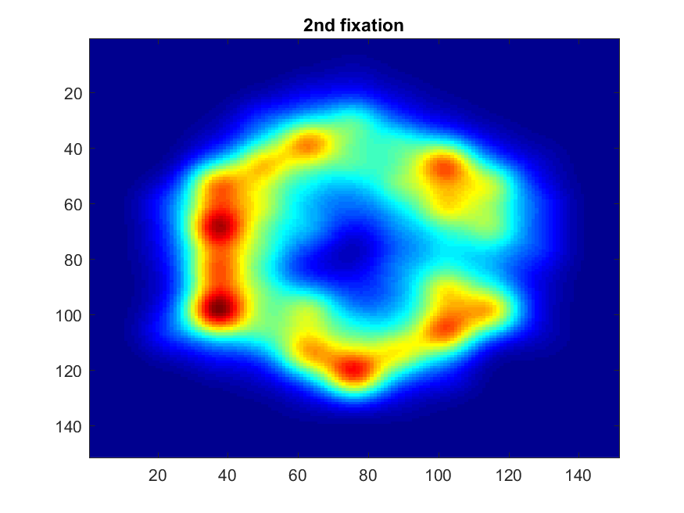
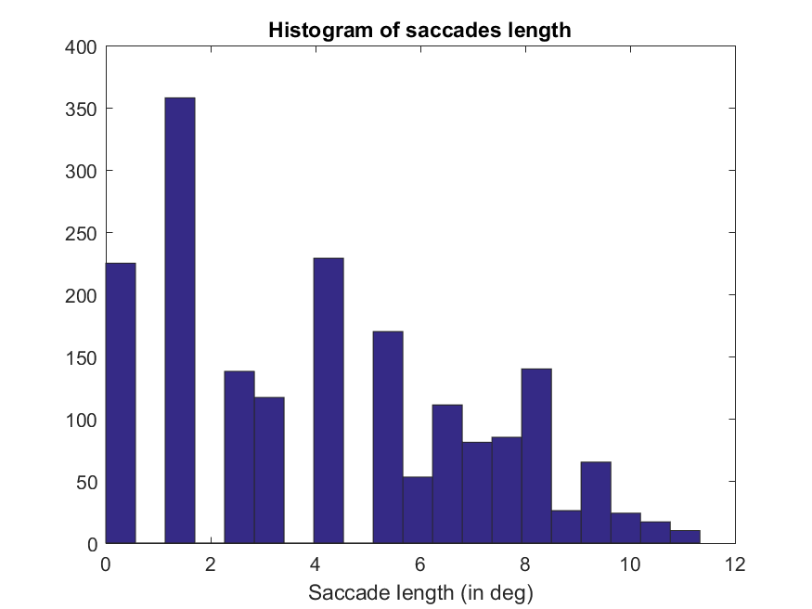
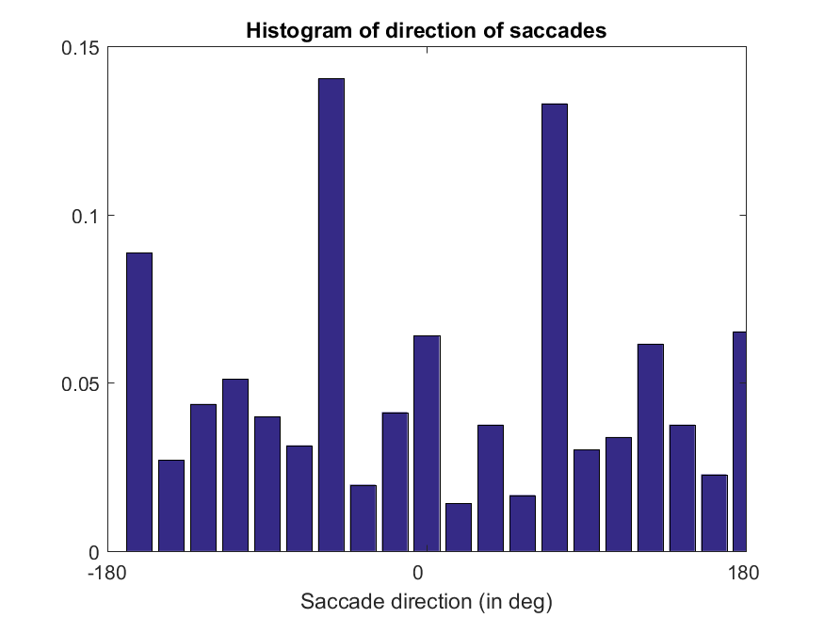
Results – ELM

Slide 31
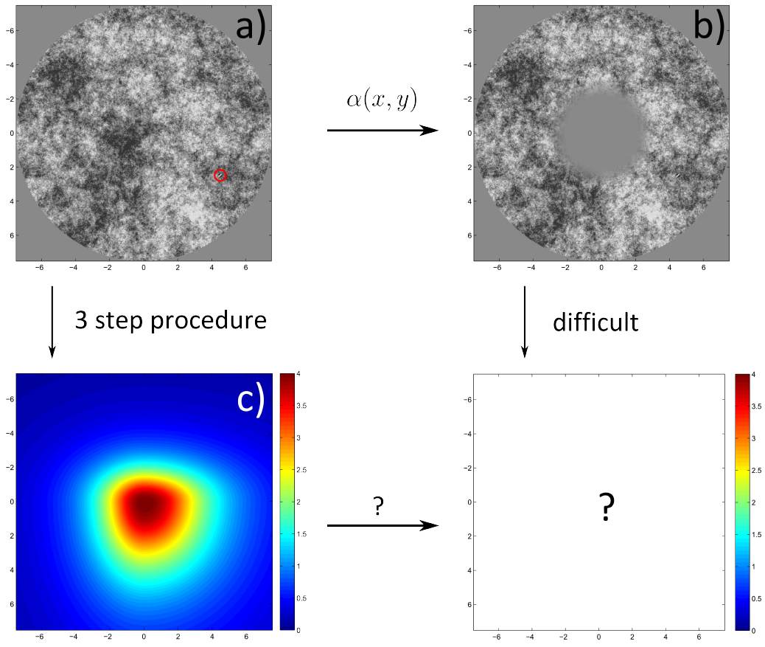

How to model central scotoma

Slide 32
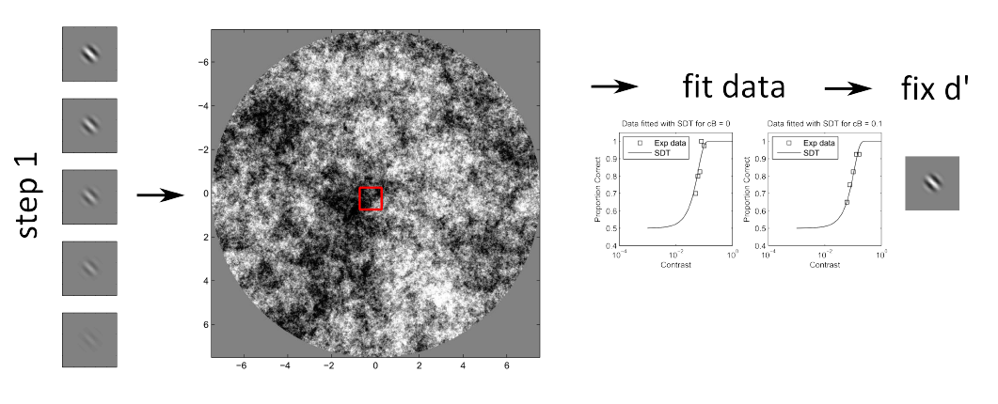
Derivation of d’ map – step 1

Slide 33
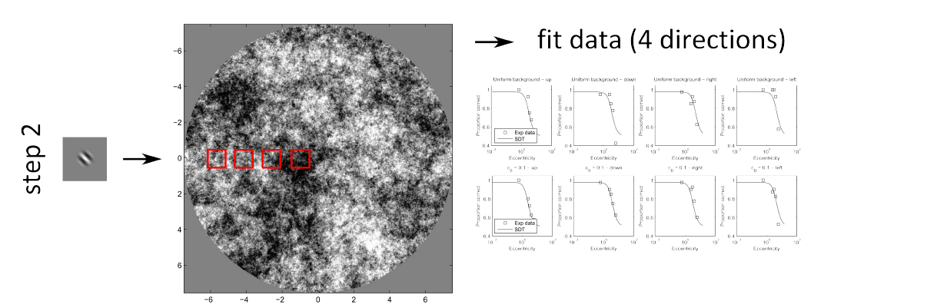
Derivation of d’ map – step 2

Slide 34


Derivation of d’ map – step 3

Slide 35


Modification of the mask

Slide 36


Slide 37
Decision feedback vs outcome feedback
IBO can give feedback based on the decision, not the outcome
You are playing poker. You are deciding, whether you should fold or not. Outcome feedback is, whether you’ll win or lose after folding. Decision feedback is, whether your answer was right or wrong decision

Slide 38
That is all
Interested in these topics?
Master theses available

